Slide 1

UNIVERSITY INSTITUTE OF TECHNOLOGY
RAJIV GANDHI PROUDYOGIKI VISHWAVIDYALAYA
BHOPAL
MAJOR PROJECT
ON
Digital Gram Panchayat Services
Presented by
Neelam Tiwari
(0101CA201019)
MCA IV Sem
MCA 404

Slide 2
LIST OF TABLES
Abstract
Introduction
Objective of project
Proposed design system
Programming Language
Flow Diagram
Screenshots
Conclusion
Future Scope
Reference

Slide 3
ABSTRACT
Digital GramPanchayat services help villagers to get easy information about the government services provided by the government for the welfare of the villagers. In this website all the work of the panchayat will be done in a digital way and the user can get every information online
Digital Gram panchayat Service is a system which helps government servants by reducing their workload and also helps other peoples who seek the services of government.

Slide 4
INTRODUCTION
The main objective of this project is to reach government service in a digital way. In this online service, the public can see the list of government services in their cell phone and they are able to get information about call register documents and may apply for online services.
With the help of this project better communication may be developed between government service providers and the public and in this way it is helpful in information distribution.

Slide 5
OBJECTIVE
Villages will get the information about government services and related documents digitally from gram panchayat.
The other objective of digital gram panchayat service is to reduce paper consumption and also the workload of servants of gram panchayat.
The Transparency of communication between gram panchayat and service users.
Villages & gramsevak work under and get information on their account .
This is to reduce the time of villagers who visits the panchayat office frequently to get the information about scheme /services

Slide 6
PROPOSED SYSTEM DESIGN
Analysis the Problem :
Today we have various scheme by the government which are dope manually still most of the work in gram panchayat is done on paper ,most of the document issued by gramsevak are on paper ,to store all those documents or paper are big challenge or problem for gramsevak or panchayat servants. Document and information related to the scheme related to villagers may be lost ,and the villager will have to apply again for that. These all increase the workload of gramsevak and also create problems for the villagers .By using digital gram panchayat service we can solve the problem.

Slide 7
Problem Definition:
Gram Panchayat office plays an important role in villagers life .Villagers mainly depend on the gram panchayat office for all the information. Gramsevak is the only person who gives the information related to scheme & documents the most of gram panchayat done their work on paper and there is time consuming process if villager wants any documents and any information related to government scheme because for these information villagers should reach gram panchayat and request to gramsevak

Slide 8
Programming language
Python
Python is an interpreted, object-oriented, high-level programming language with dynamic semantics. Its high-level built in data structures, combined with dynamic typing and dynamic binding, make it very attractive for Rapid Application Development, as well as for use as a scripting or glue language to connect existing components together
Django
Django is an advanced Web framework written in Python that makes use of the model view controller (MVC) architectural pattern. Django was created in a fast-moving newsroom environment, and its key objective is to ease the development of complicated, database-driven websites. This Web framework was initially developed for The World Company for managing some of their news-oriented sites. In July 2005, it was publicly released under a BSD license.

Slide 9
Sqlite,Html,Css
Sqlite for database
. SQLite is a “light” version that works over syntax very much similar to SQL. SQLite is a self-contained, high-reliability, embedded, full-featured, public-domain, SQL database engine. It is the most used database engine on the world wide web. Python has a library to access SQLite databases, called sqlite3
Html
HTML stands for Hyper Text Markup Language
HTML is the standard markup language for creating Web pages
Css
Cascading Style Sheets (CSS) is a stylesheet language used to describe the presentation of a document written in HTML or XML CSS describes how elements should be rendered on screen, on paper, in speech, or on other media

Slide 10
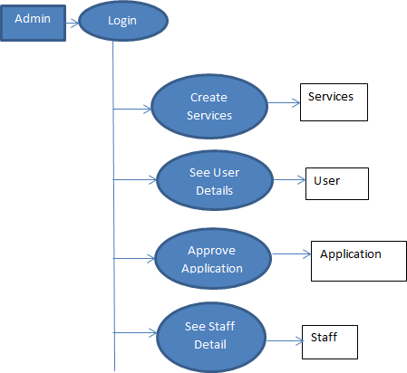
FLOW DIAGRAM
Data Flow Diagram for Admin

Slide 11
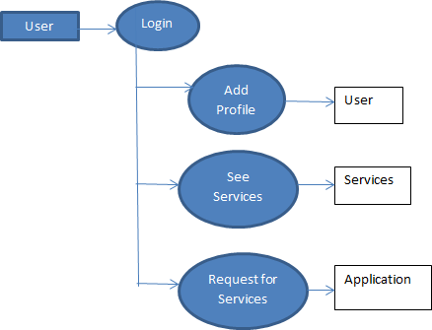
Data Flow Diagram for User

Slide 12
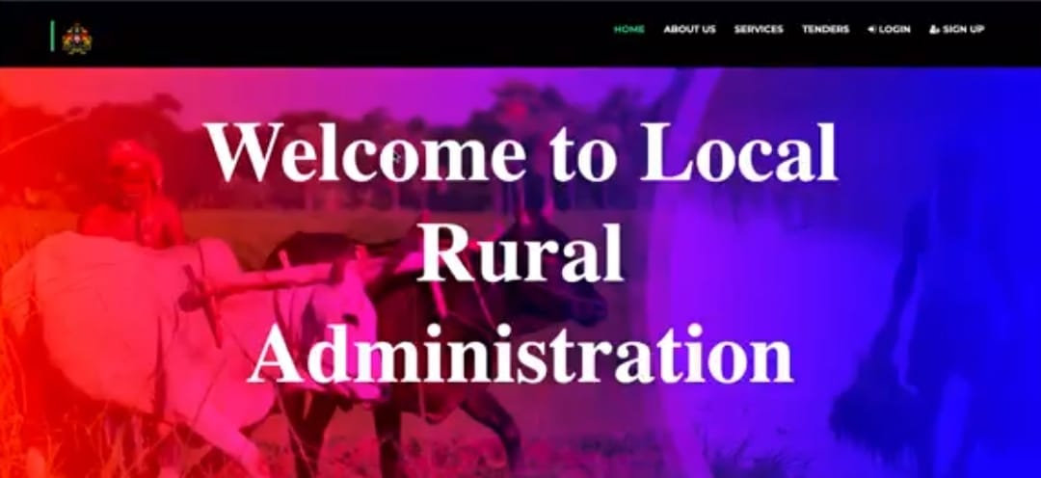
Screenshot 1
Above screen shot shows the home page in which we can login for the admin, and villagers or users by login in it.We can make necessary changes to the schemes, registration of the users, and schemes addition with the details

Slide 13
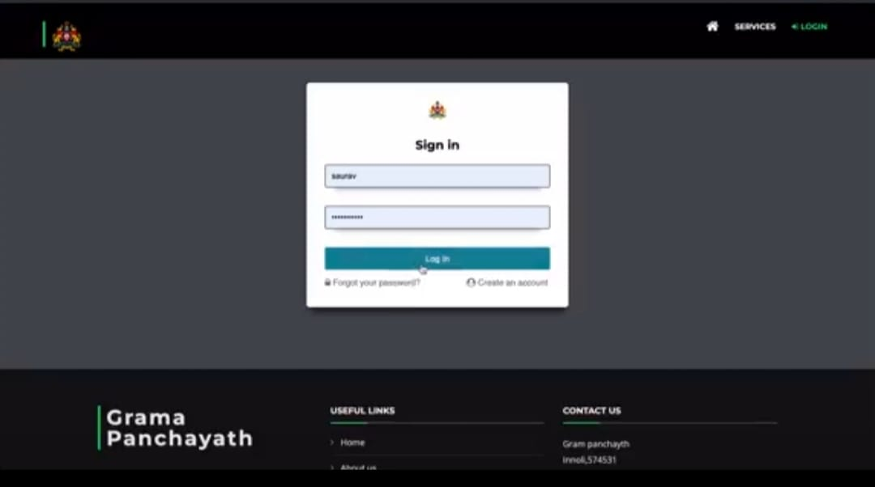
Screenshot 2
Above Screenshot shows the registration page which is used for user registration .For login in this portal users need to login id and password and this registration stores all the required information about the user and after the registration user gets their login id and password.

Slide 14
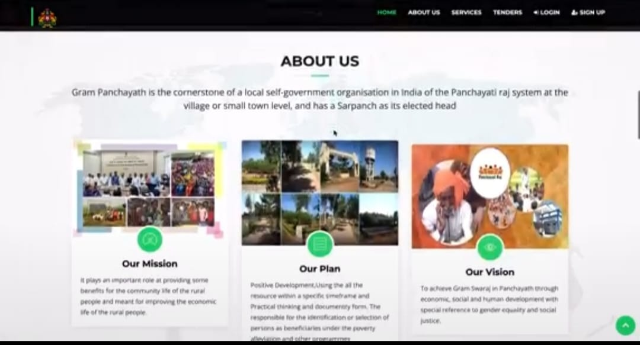
Screenshot

Slide 15
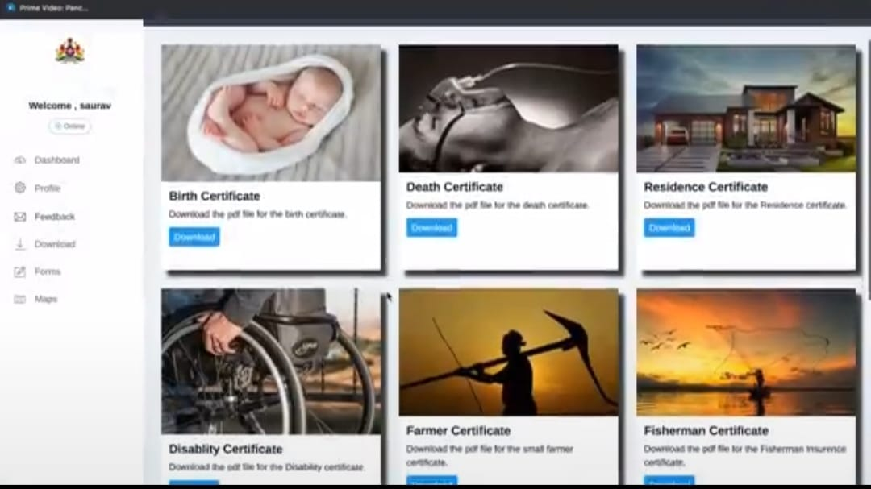
Screenshot 4

Slide 16
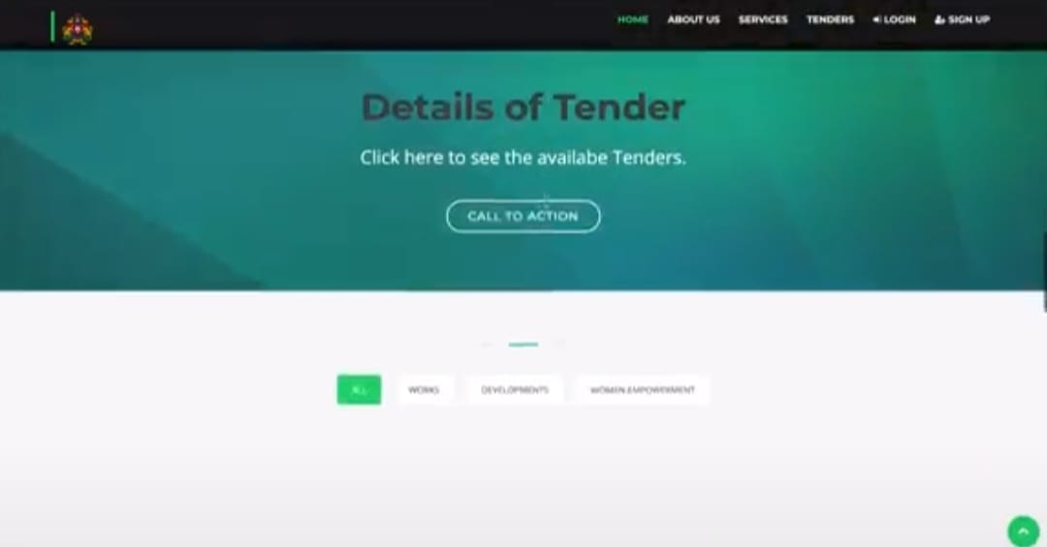
Screenshot 5

Slide 17
CONCLUSION AND FUTURE SCOPE
Conclusion:
This web based application will be helpful to the villagers of that village; it will bring transparency, accountability, and efficiency in administration. Document and their related record will be available on this application. It helps to make administration more accountable as well as more transparent. The above survey and proposed system will help the Gram panchayat system to work efficiently. This system provides ID and password for the villager. Account history provides information about the services that are previously submitted by the villagers. Both analysis and evaluation results confirm that the proposed web base system can provide an effective solution for submitting the services/schemes that are useful for the villagers in online mode. This will help to minimize corruption in the system, and also save the effort and time of common man and government officers

Slide 18
Future Scope:
This system has been designed keeping in mind the requirements of gram panchayat staff and enables the admin and staff of panchayat to make entries in the database about villagers, personal details, and their related services. This system also provides him the authority to manipulate his account .we can add much more feature in the system i.e., alert system ,receive notification to user and gram panchayat staff about some action ,we can provide a transaction system in which all the money related work handled will save time and will reduce corruption. By using this system data collected from different gram panchayats will be helpful for implementing different schemes and will help in natural calamities and data can be useful in other fields.

Slide 19
REFERENCES
Totare, Sagar Hanumant, et al. "E-Gram Panchayat Management System.“
hanikasalam, S., and S. Saraswathy. "Role of Gram Panchayat in Rural Development: A Study of Vagurani Village of Usilampatti Block of Madurai District (Tamil Nadu)." International Journal of Humanities and Social Science Invention 3.1 (2014).

Slide 20


